Slide 1

Offender Management System
By:
Mohan Krishna Alli
Jagruthi Kesha
Rahul Reddy Kommidir
Anoosh Koneru

Slide 2
Abstract
Aim to modernize the legacy systems to web based management applications.
Traditional systems takes long time to finish up a single data flow entry and this led to loss of information of some cases (crime files), insecurity and data redundancy.
These necessity makes us automating the system to make it more secure, efficient and effective.
These System tracks the Offender Activities by the Staff Member
Here Staff Member is the Supervisor of the system

Slide 3
EXISTING APPLICATION
Current application works only with internet explore and no browser compatibility.
These system handle the offender activities from “admit to release”.
If the data is increased, it is difficult to organize and retrieve the accurate data when required.
No accurate in system response.

Slide 4

New Application
In these system “staff member ” is the supervise the offenders
Staff member handles the offender data from “admitting in to jail to release from system”.
These System involves in six modules
1.Global Search.
2.Create Offender.
3.Bookings.
4.Incident Reporting.
5.Scheduling and Legal Cases.
6.Release.

Slide 5
Functional Description
● Global Search : These Procedure explains how to retrieve any offender record in the system where they are active or inactive .
● Create offender : These create offender form is used to assign a unique ID number. These number will be theirs for life.
● Bookings :These module includes the following and these module use to locate the bed in the jail and update the personal, educational/work, physical characters, Languages and alerts with address.
● Incident reporting: These module records the incident that occur at your facility.
● Scheduling : These module explains about the scheduling the offenders to the court.
● Legal Case management system : Court cases and hearing notifications with charges are managed here.

Slide 6

Global Search
● These Procedure explains how to retrieve any
offender record in the system where they are
active or inactive .
● There 3 ways to Query the offender records by
Offender Name, Date of Birth and ID.
● Mandatory Fields are Offender Name , DOB and
Id

Slide 7
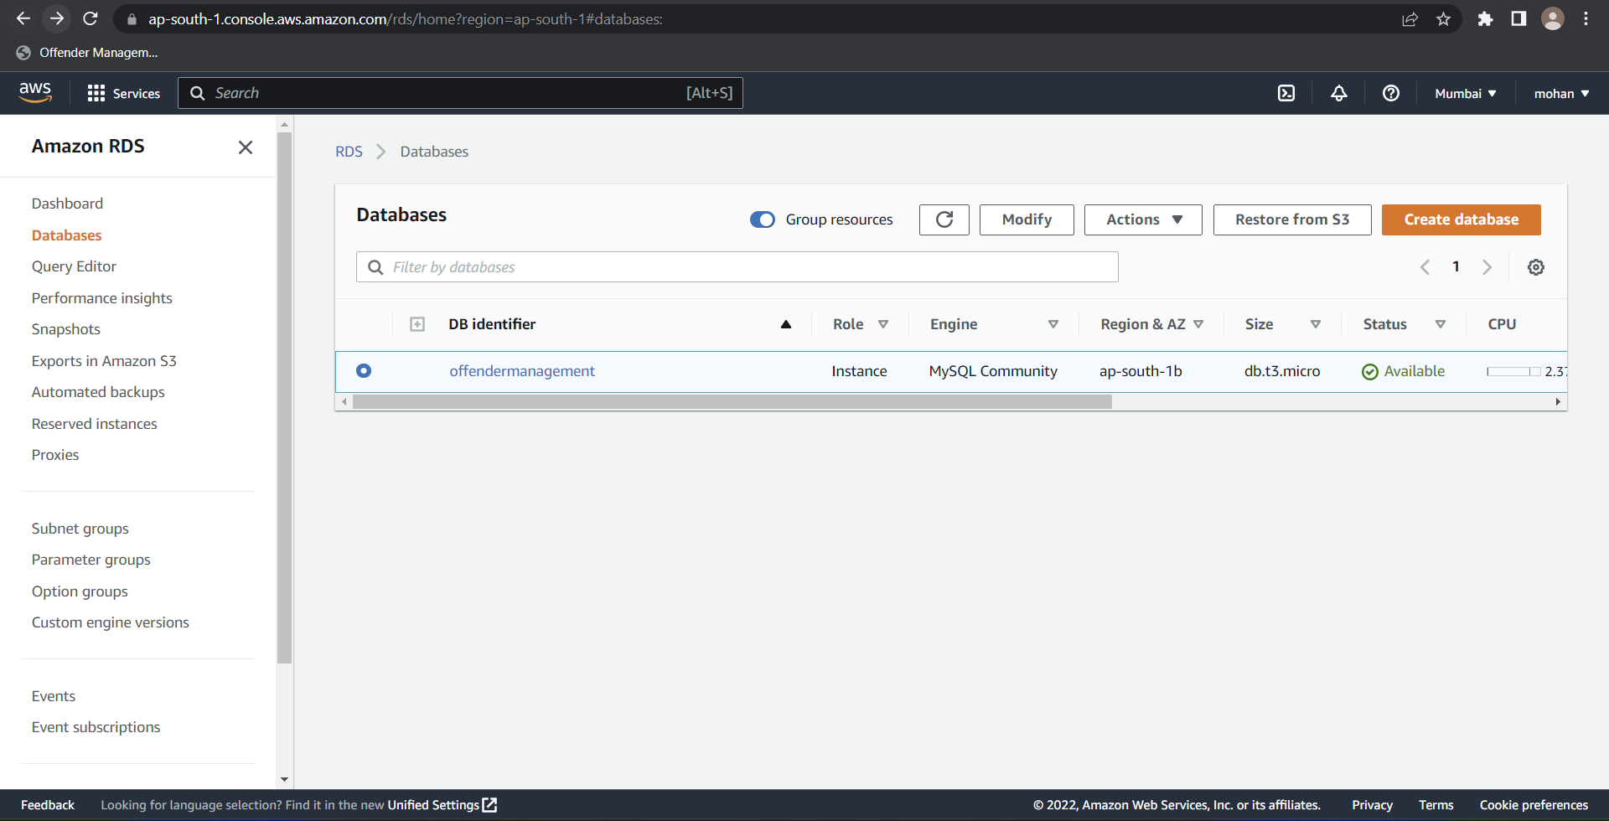
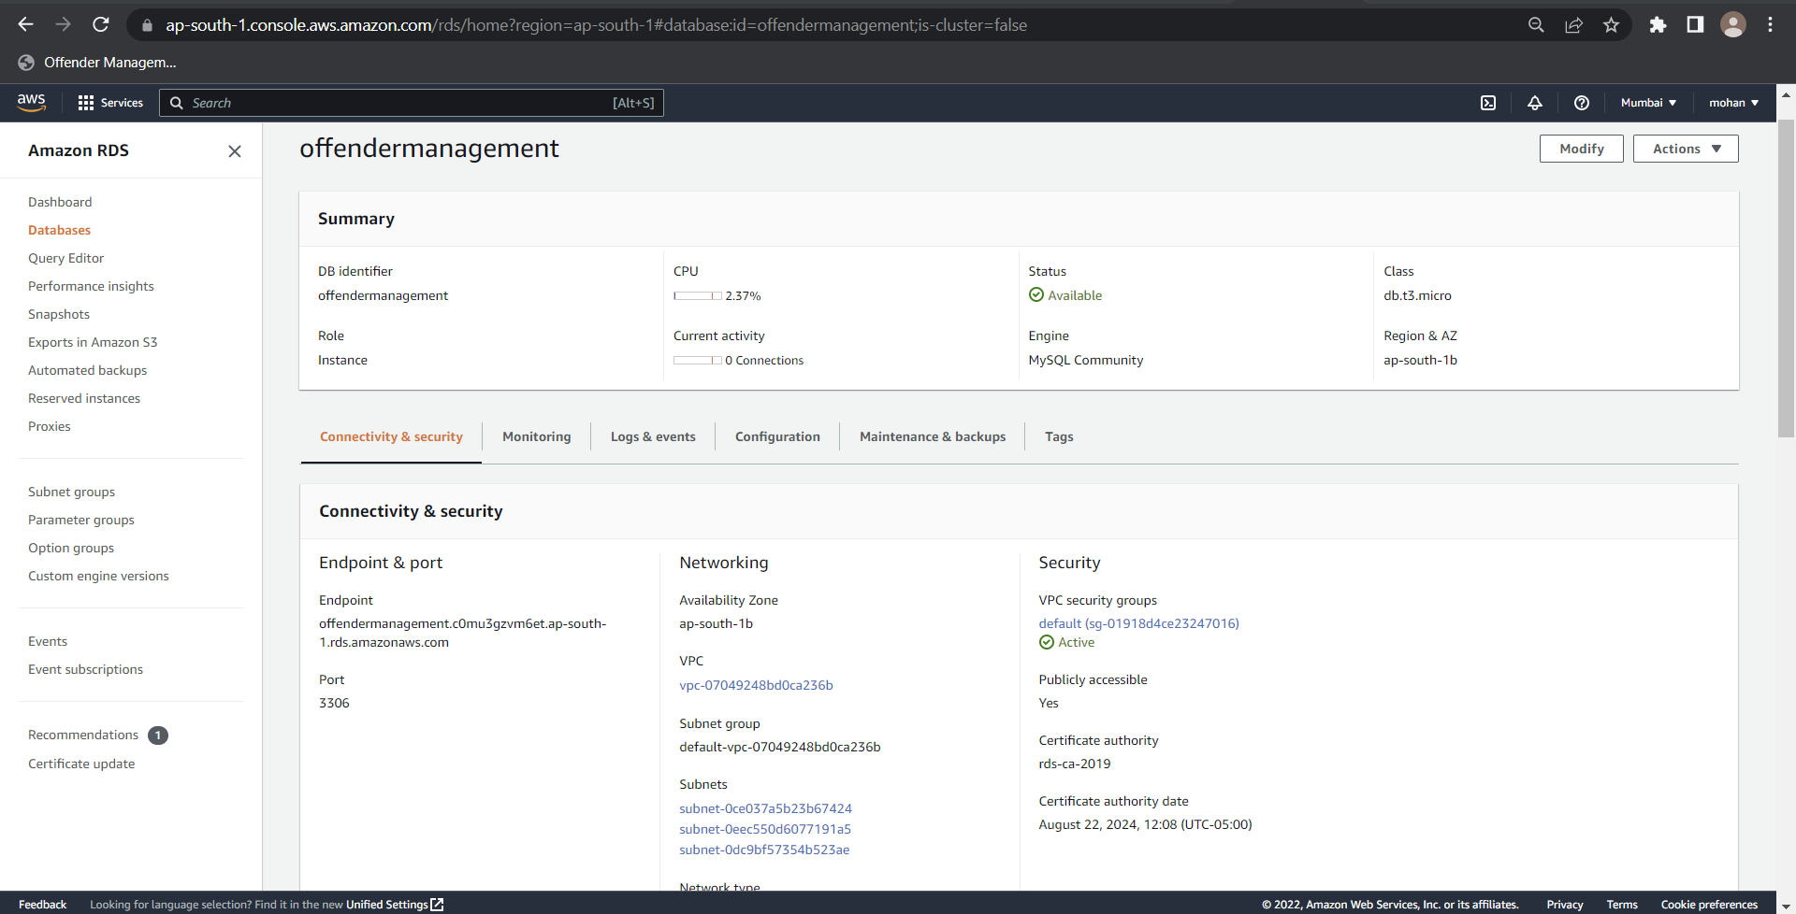
Data Base RDS

Slide 8
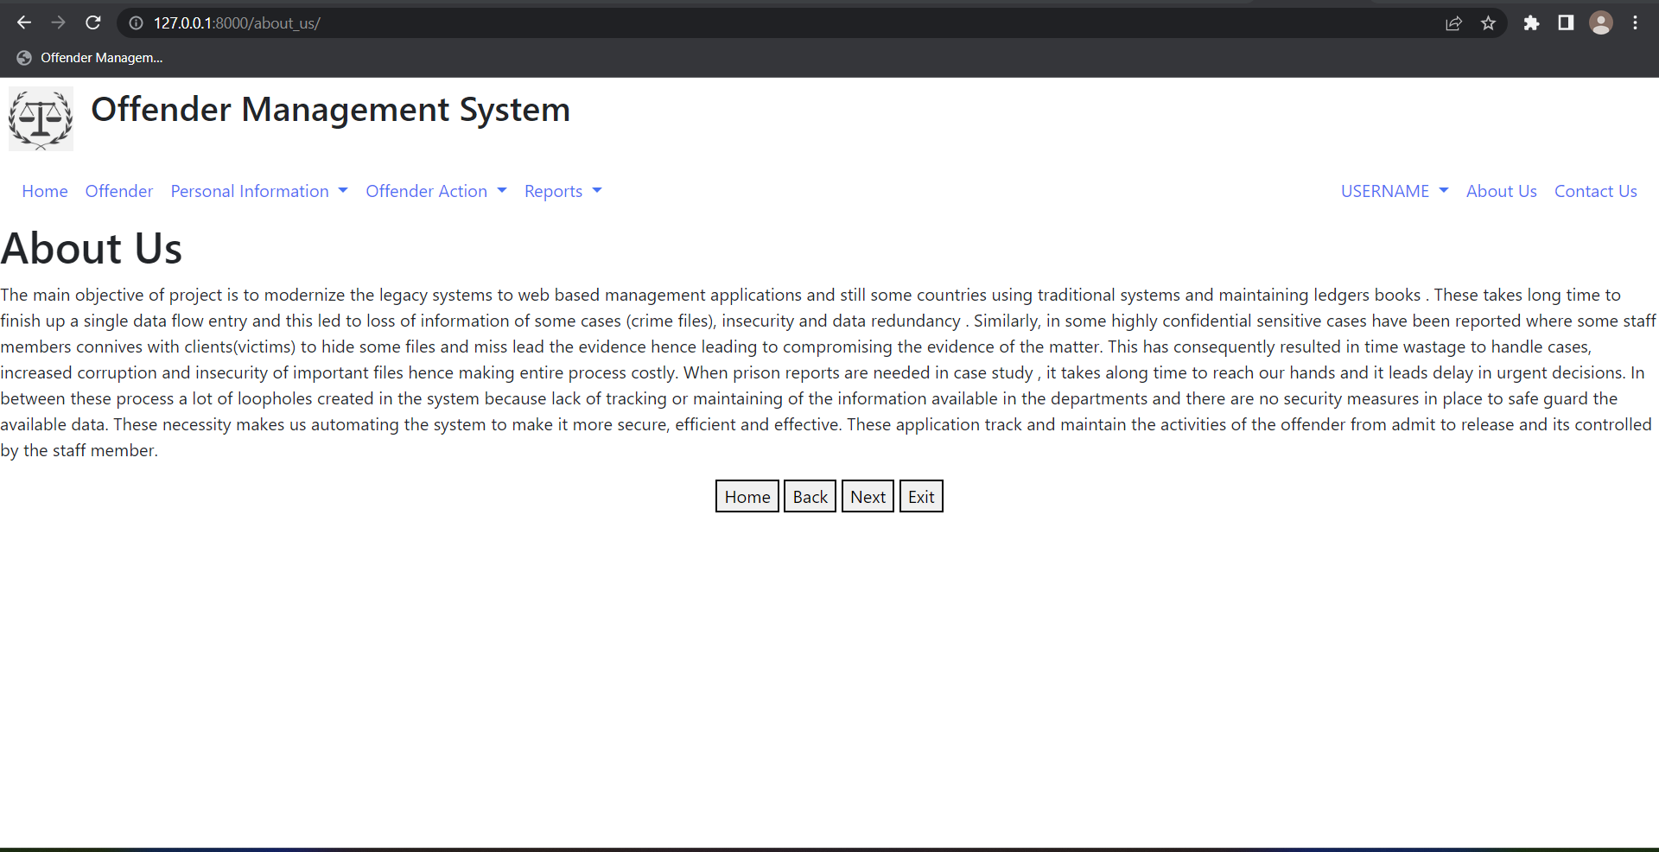
About Us

Slide 9
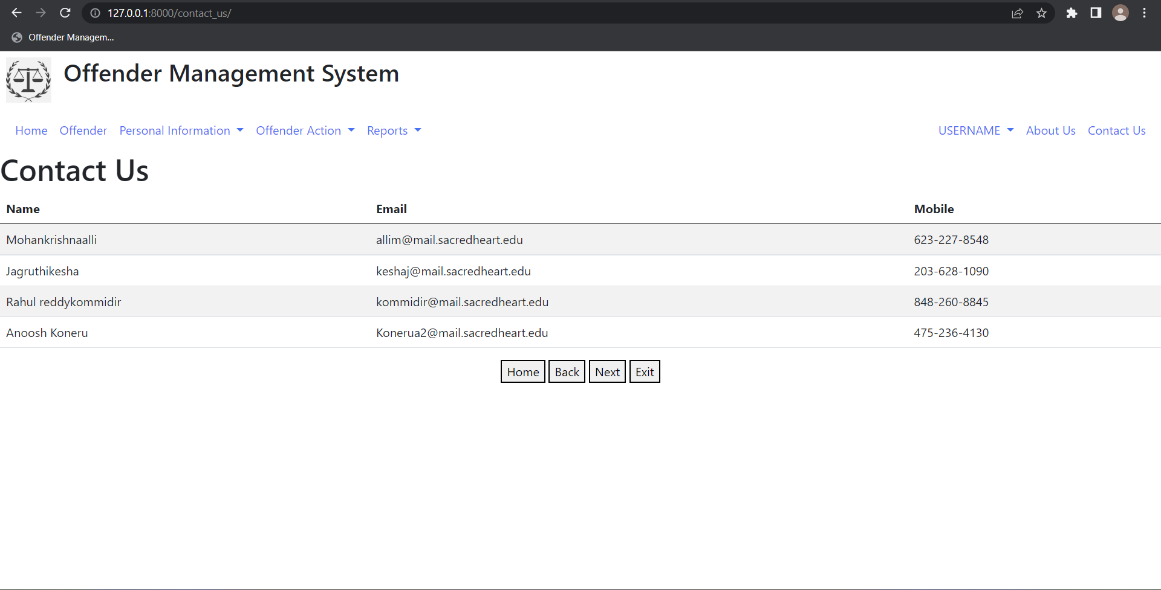
Contact Us

Slide 10
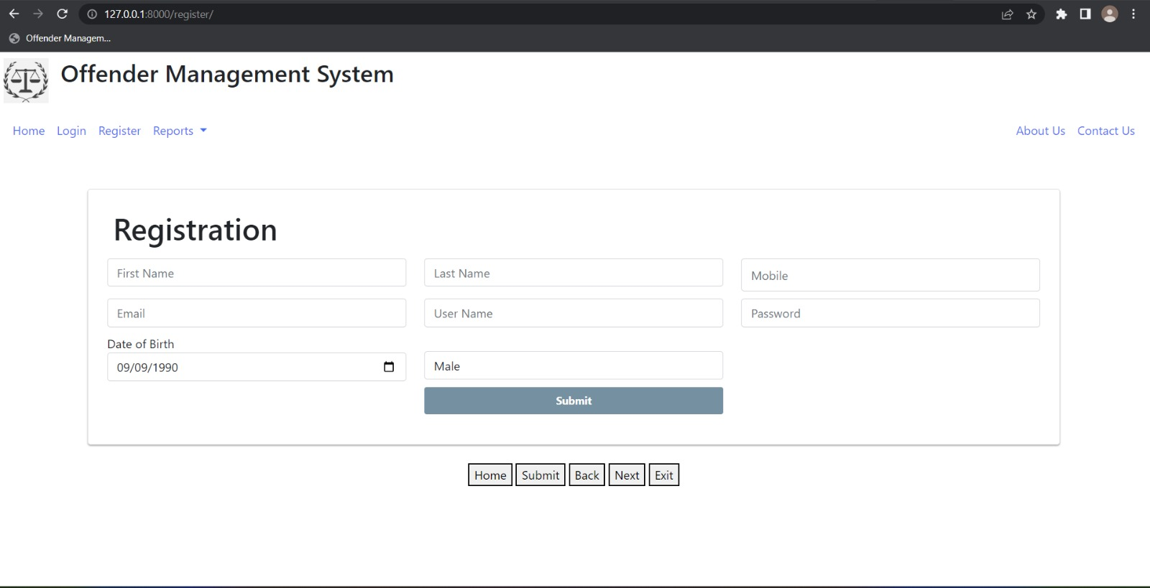
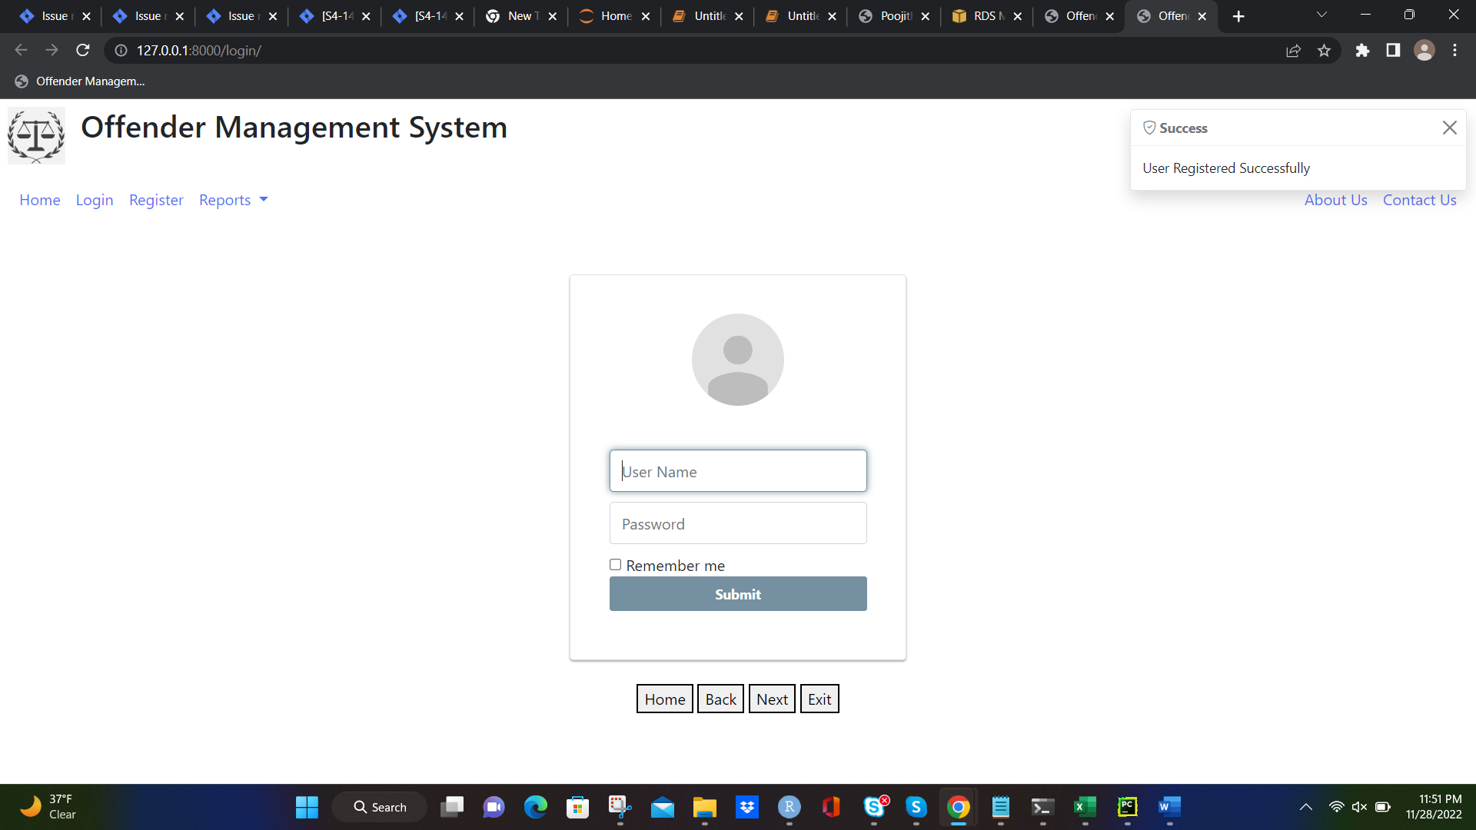
Registration

Slide 11
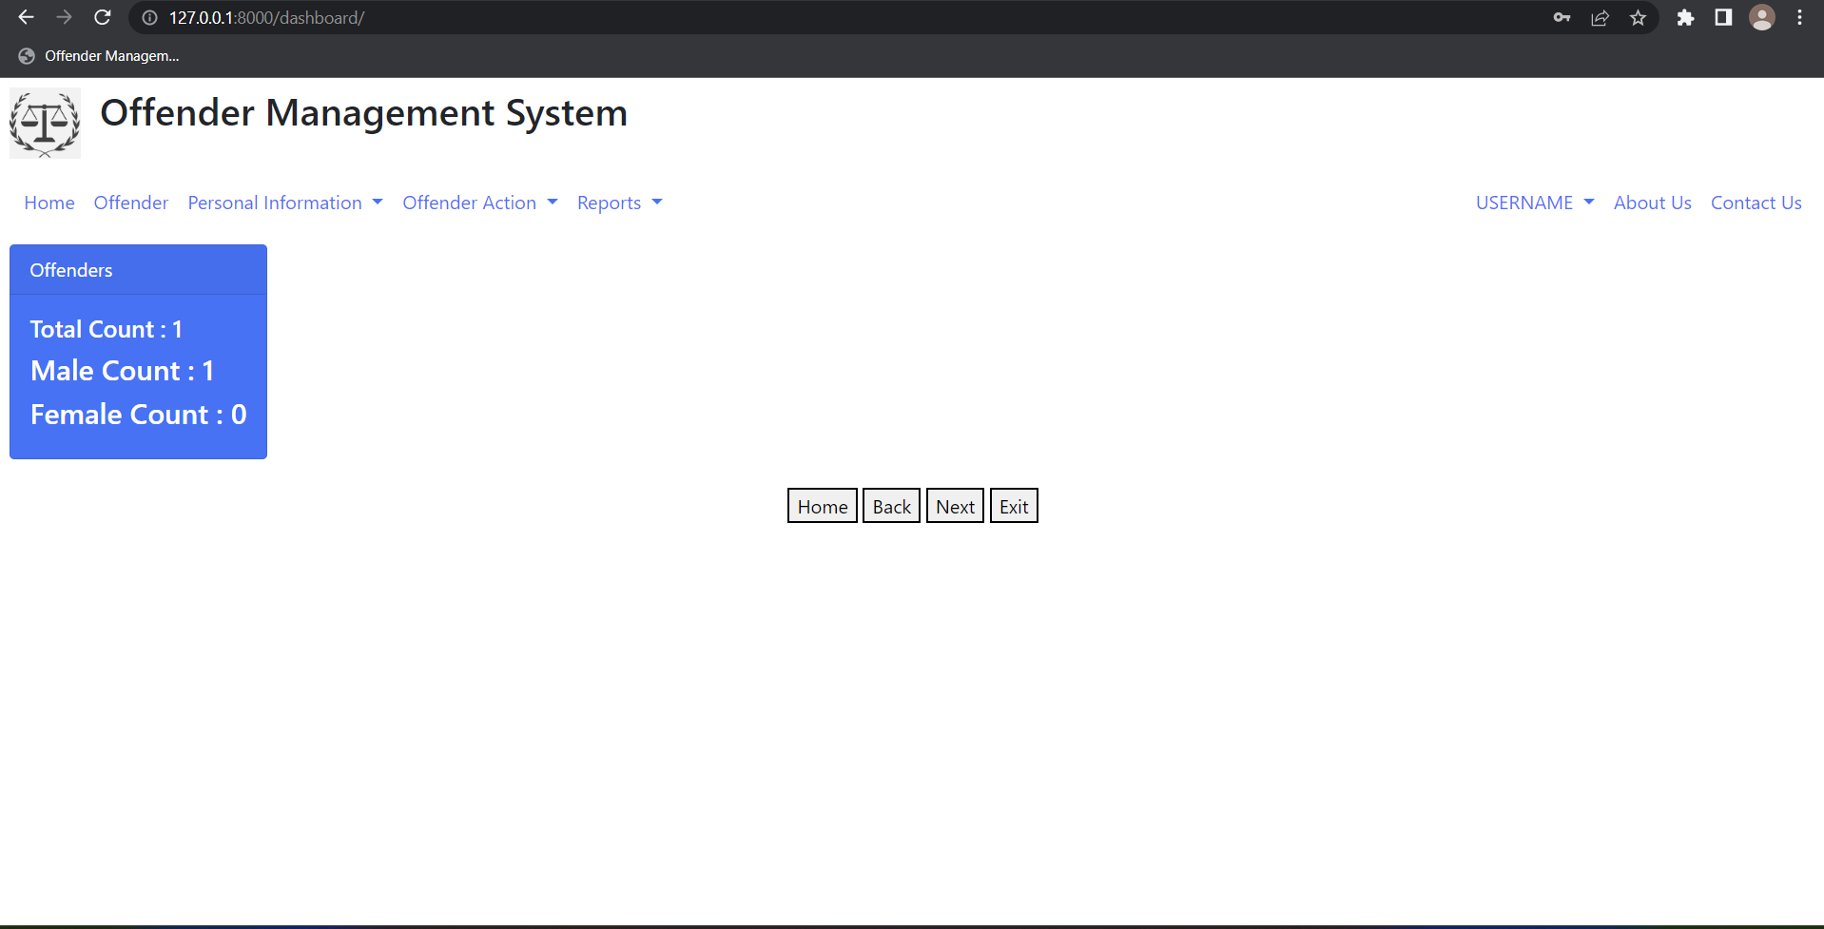
Reports

Slide 12
Create Offender
● These Procedure explains how to retrieve any
offender record in the system where they are
active or inactive .
● User need to fill up all required data to save the record.
● Last Name, First Name, Gender, DOB and ID are mandatory fields here.
● While Saving if user miss any entry. It display System Validation.
Example : Please Enter The Last Name.

Slide 13
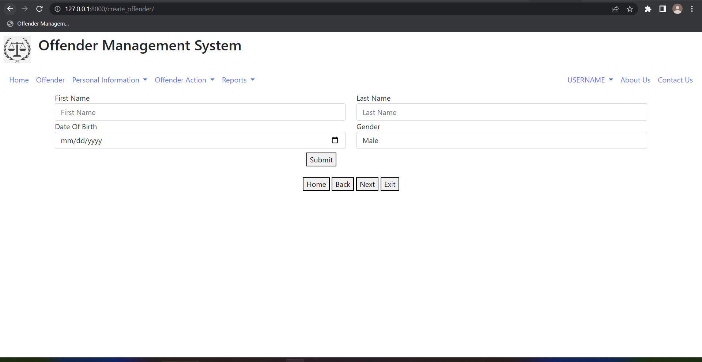
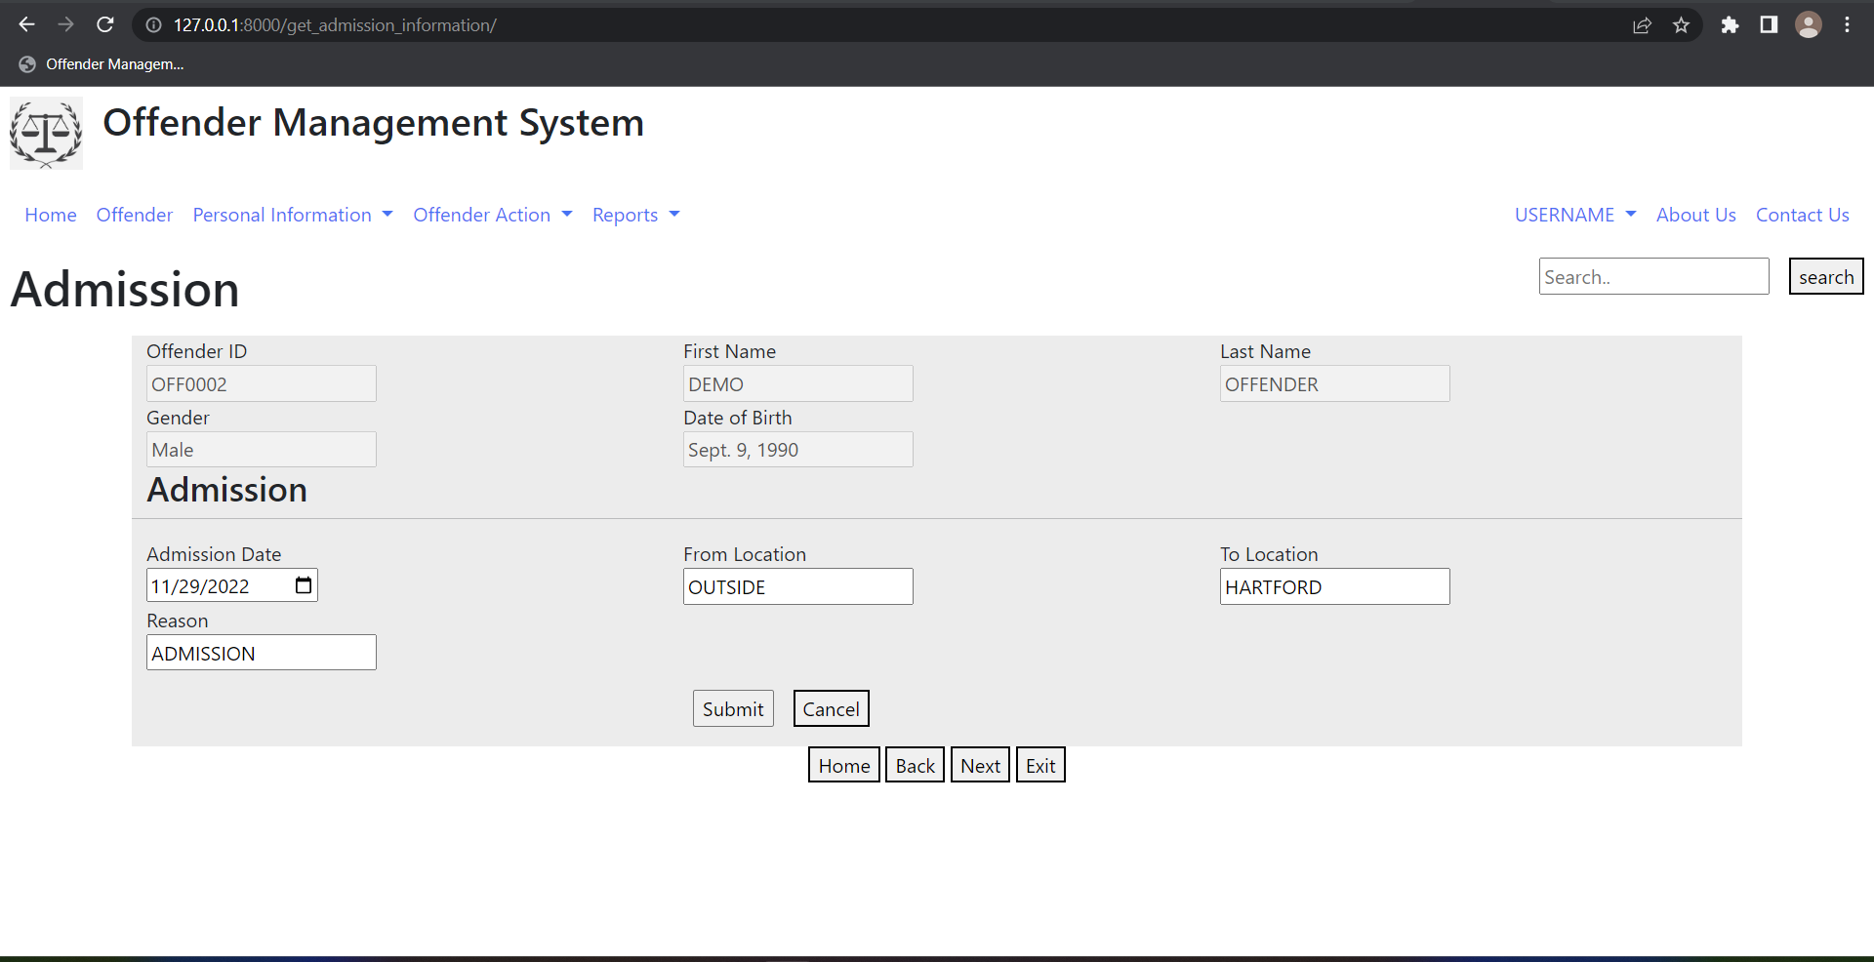
Add Offender

Slide 14
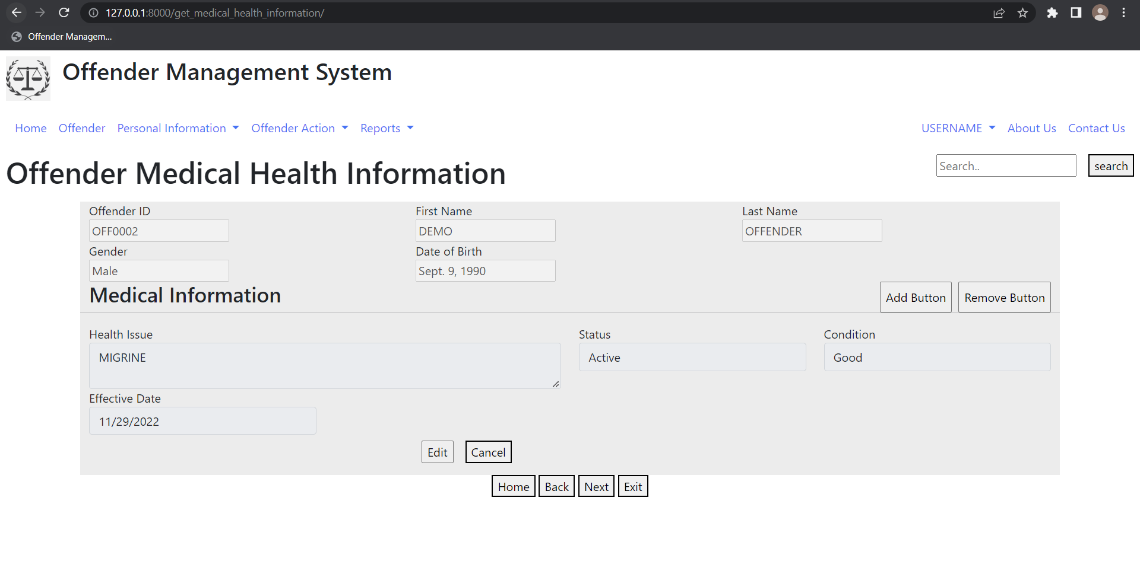
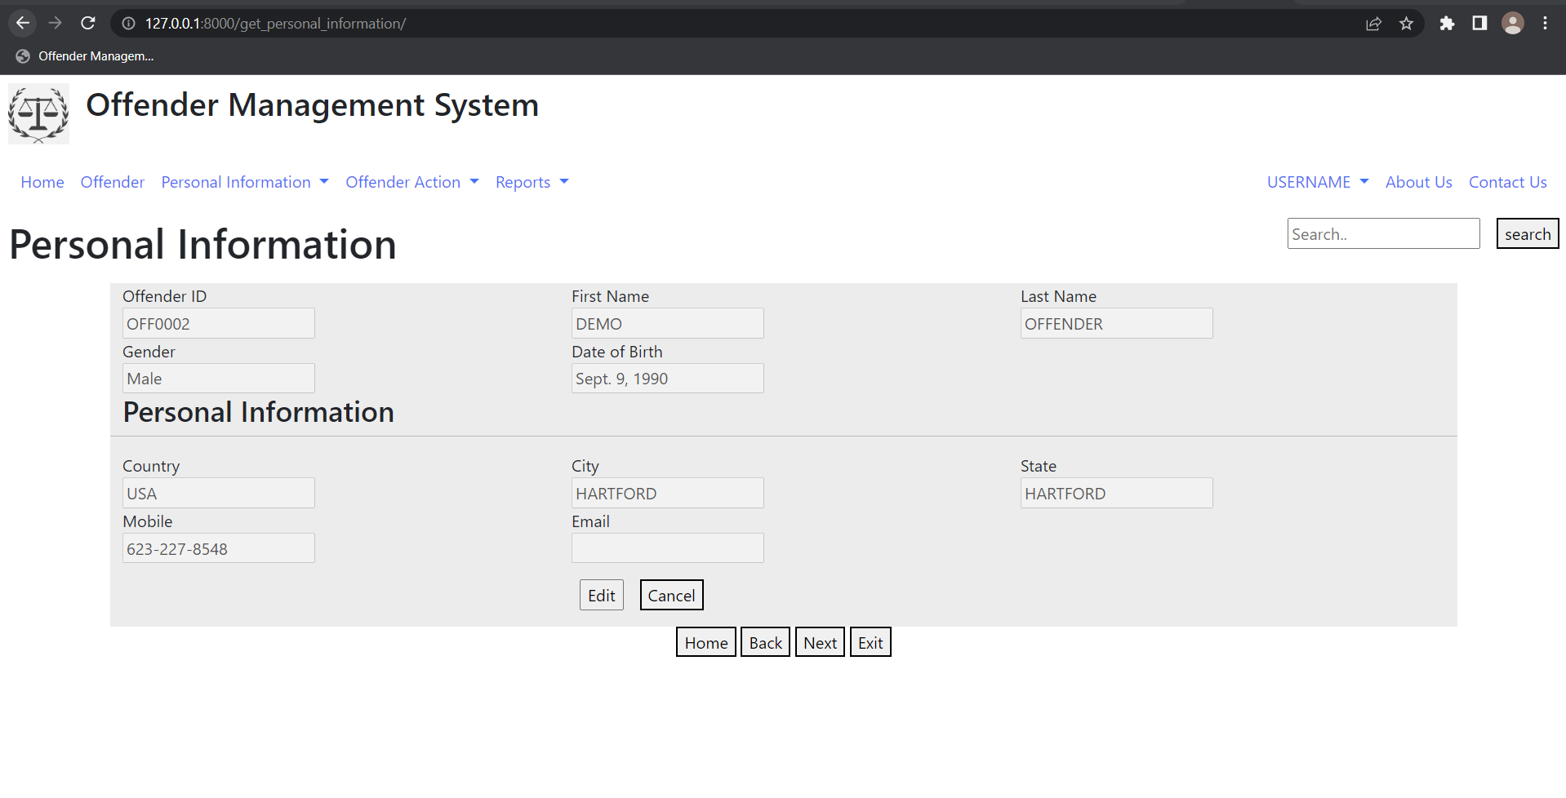
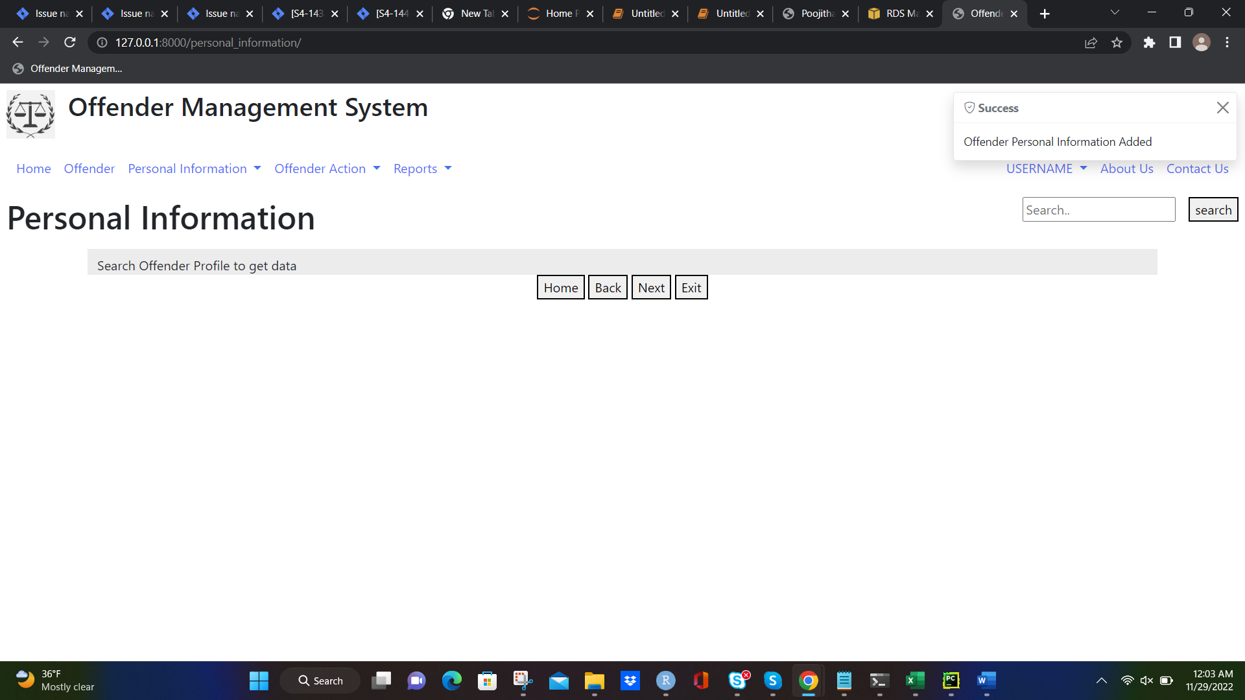
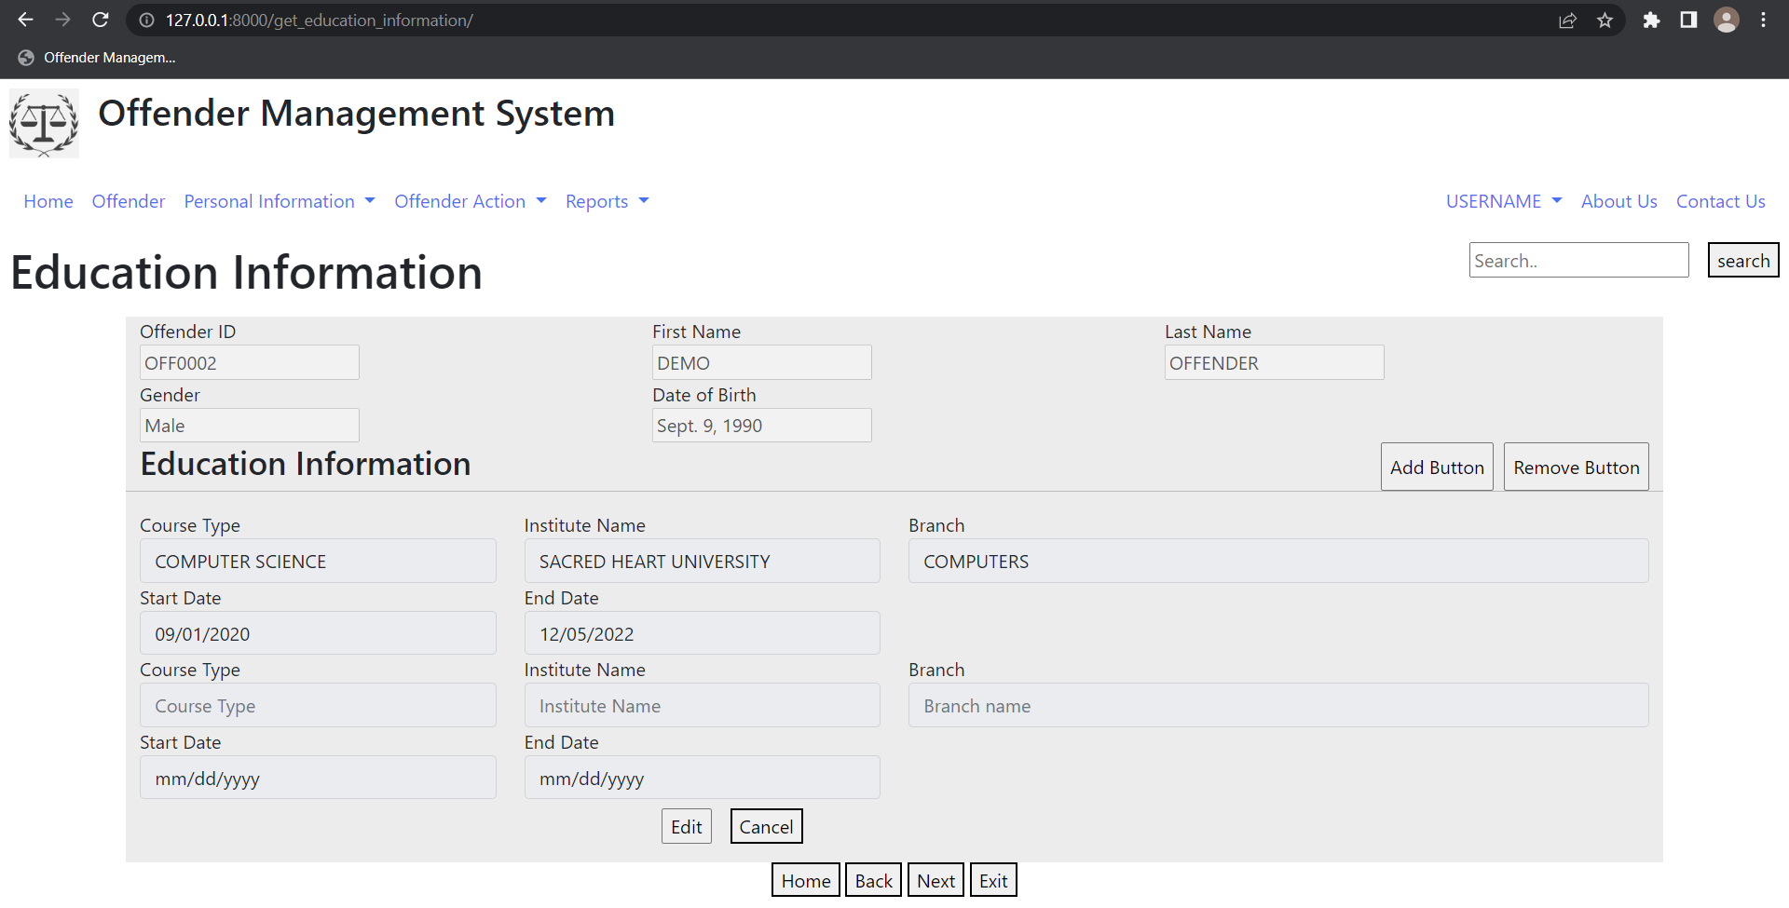

Slide 15
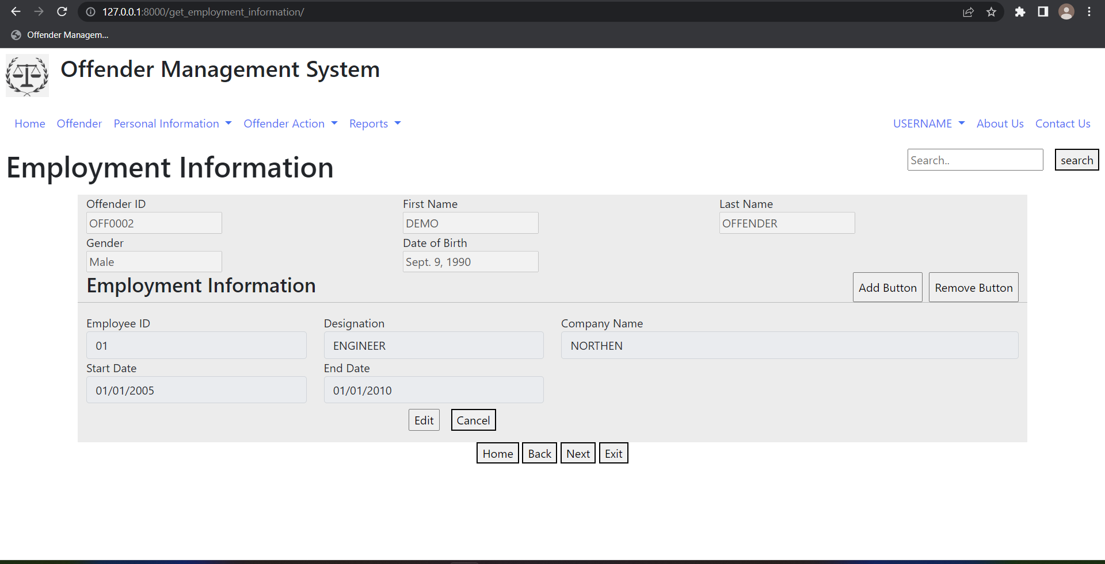
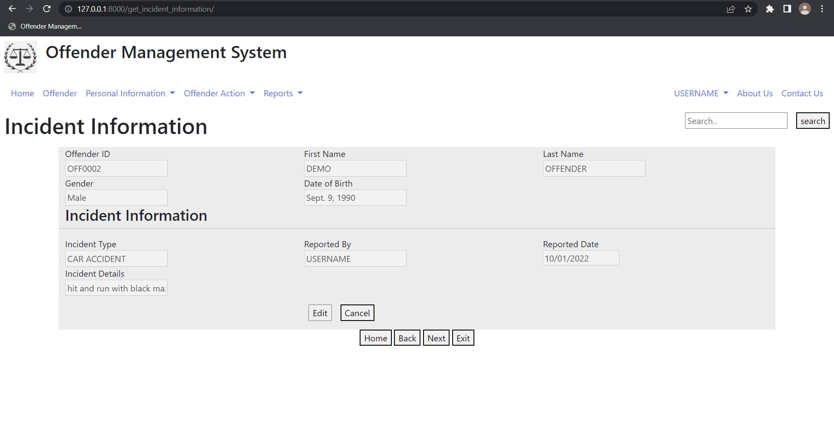
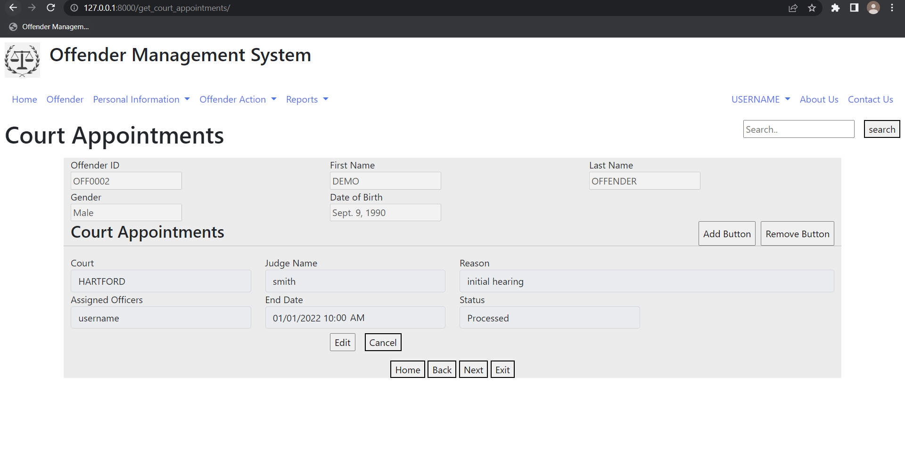
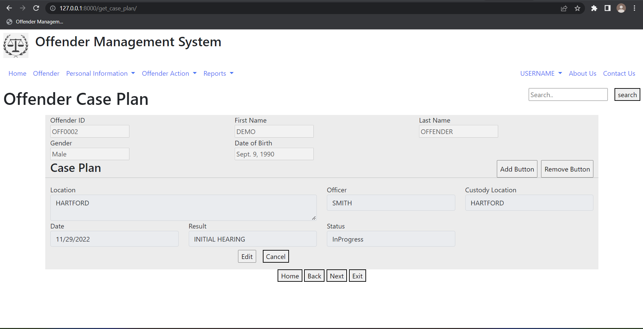

Slide 16
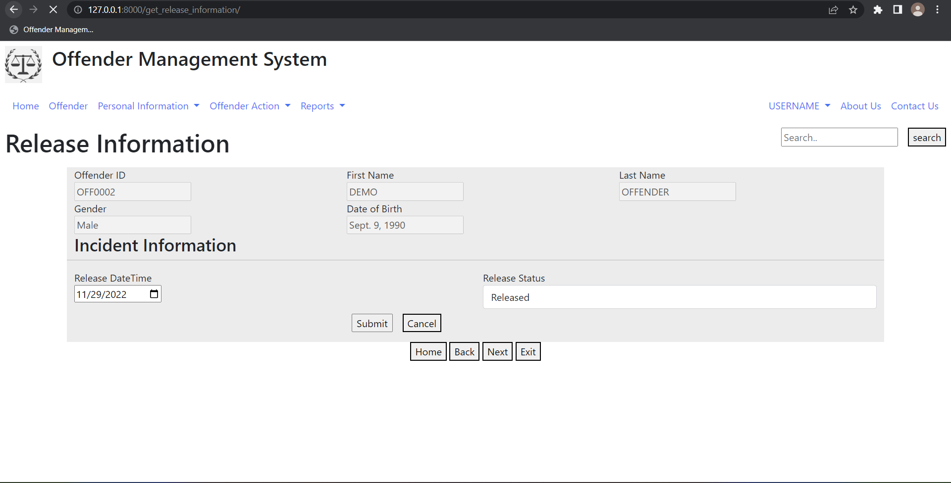
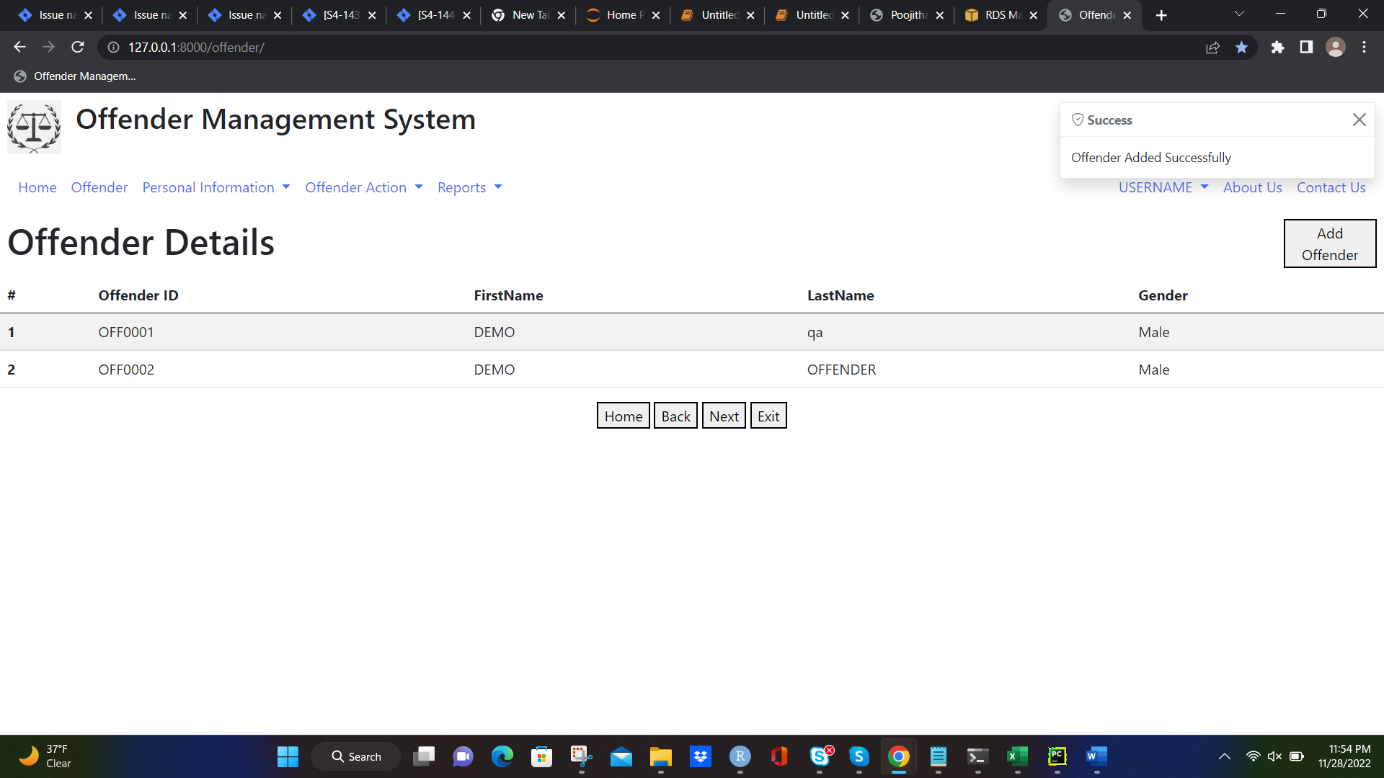

Slide 17
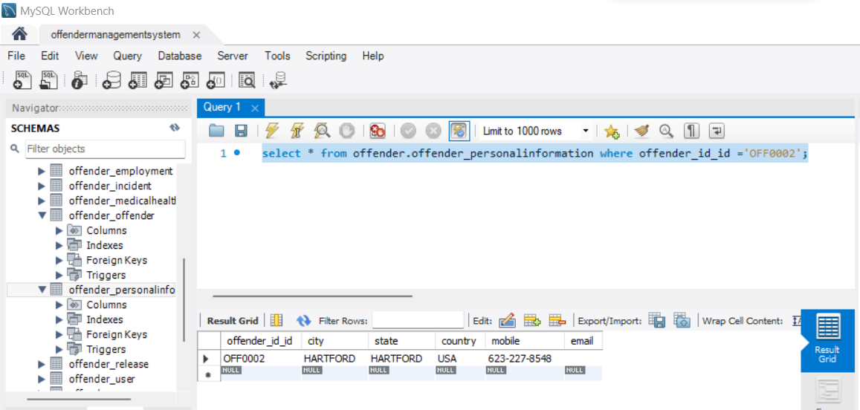

Slide 18

Forms in Incident Reporting Module
● Incident detail recording: These form is used to record the details of incidents occur at and record the information about damages resulting from incident, or any officer involved in the incident, In situations where there is offender involvement
● Incident Logs : These form used to retrieve the all-incident logs and It generates id.

Slide 19

Scheduling and Legal Cases
● Schedule appointment: These form can be used to schedule the offender to court hearings and cases.
● Schedule Transfer: These form can be used to transfer the offenders from one location to other locations.
● Legal Cases : These form is used to create a court cases with dates with offenses and sentences and bail details.

Slide 20
Data collected by the system
● In this offender management system, we usually collect and maintain the data of the offenders arrested in various crimes.
● We maintain a database with respect to locations and the offender age and imprisonment.
● This system also holds a database to maintain the schedules of offenders for their medical checkups, counselling sessions, court sessions or family meetings.
● For each offender a unique ID is provided that helps in retrieving their respective data

Slide 21
Methods
● In this system, staff member is the owner/administrator who adds the data of each offender and updates all available record statuses for system record.
● Staff member adds all the schedules of each offender.

Slide 22

Data Base Storage
● The complete data of the system is stored in Sequential format in a database. This format allows in easy store & retrieve of data.
● It is hosted in the server making the system to accessible from anywhere through the valid credentials.
● We use SQL for data storing and managing. Maintaining backups for data is taken care to ensure performance of the whole system

Slide 23
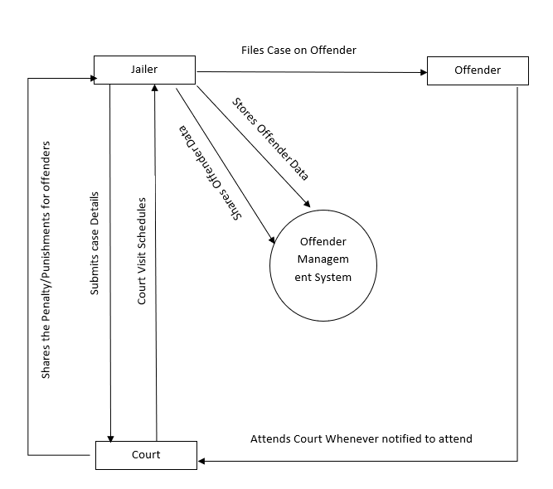
Preliminary Process Model - Data Flow diagram (DFD)

Slide 24
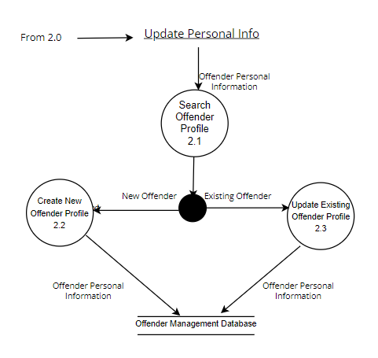
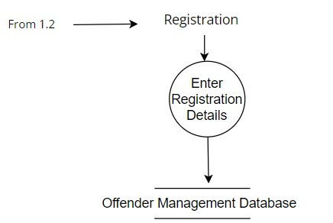
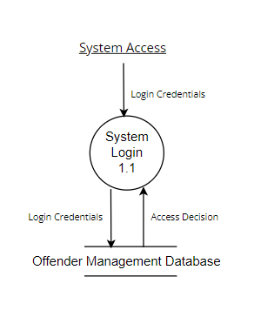
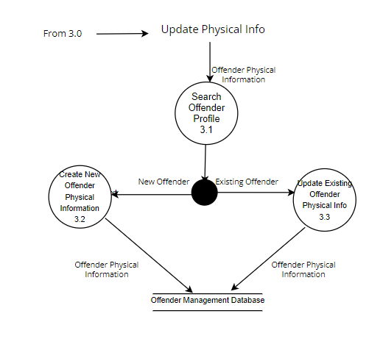
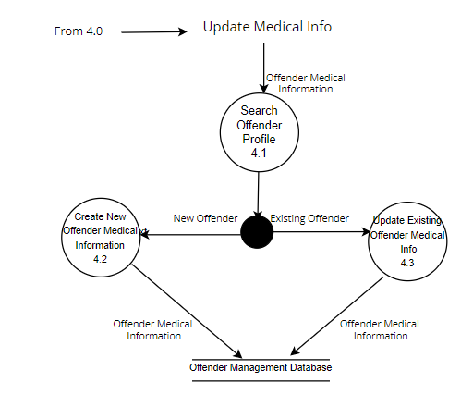
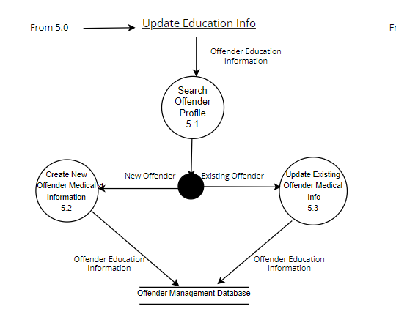

Slide 25
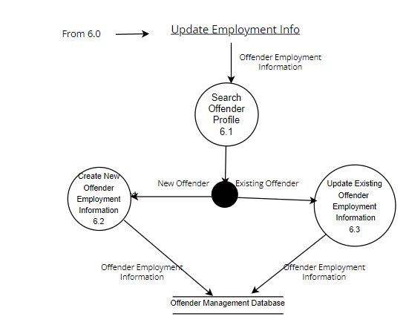
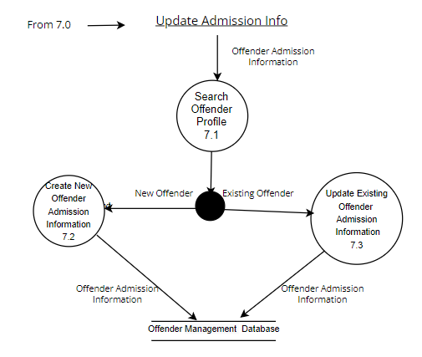
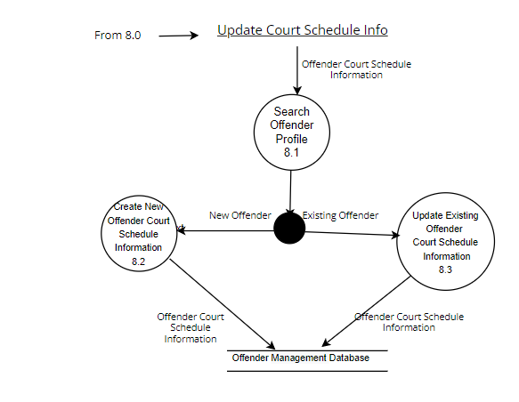
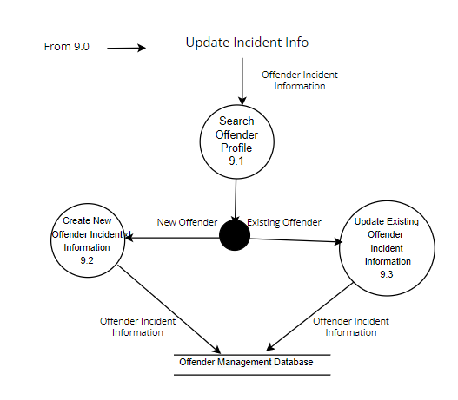
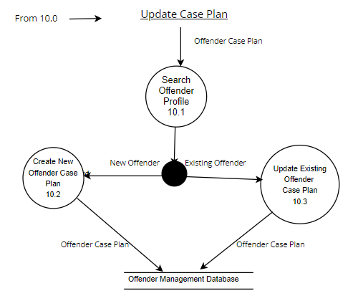
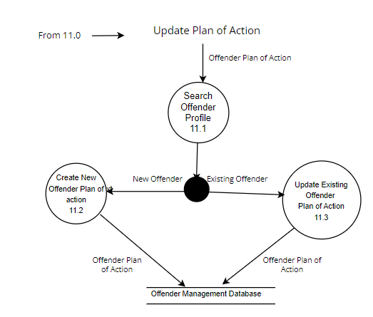

Slide 26
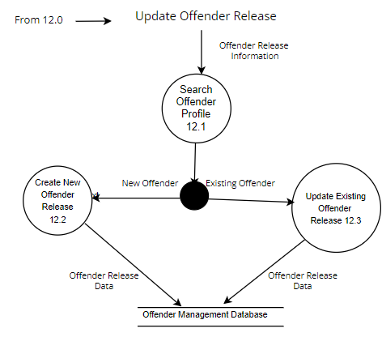

Slide 27
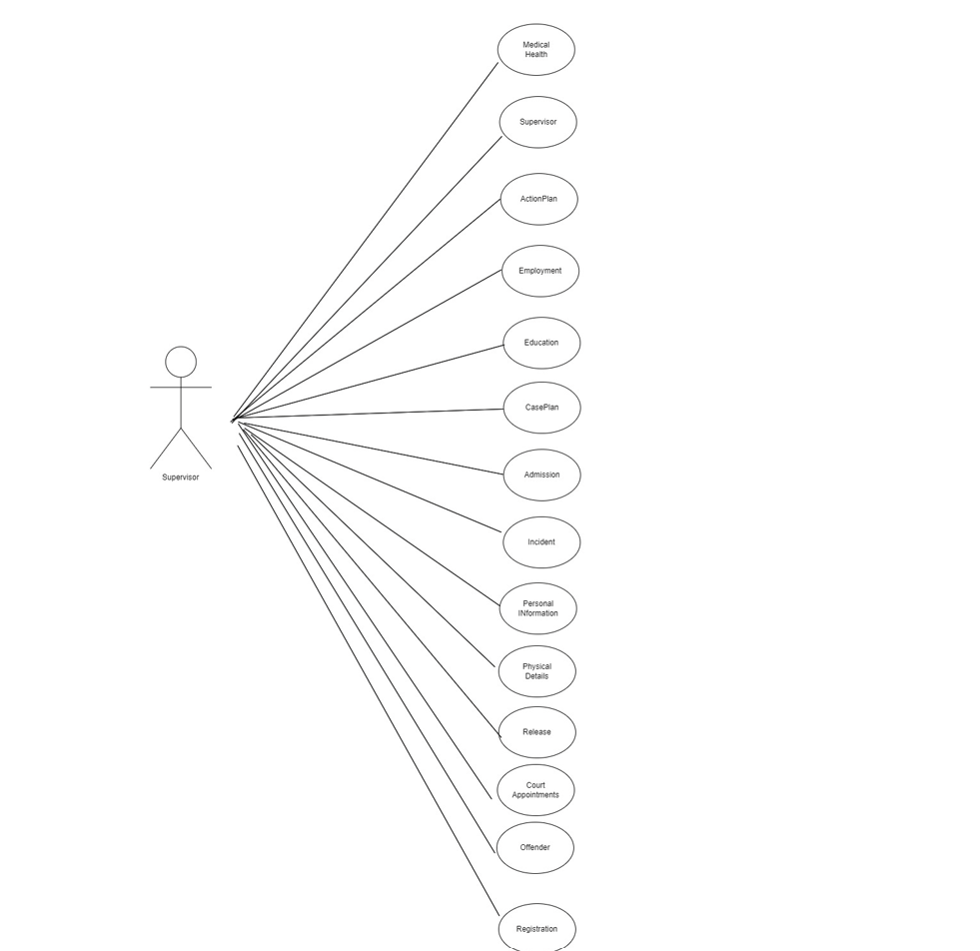
Usecase Diagram

Slide 28
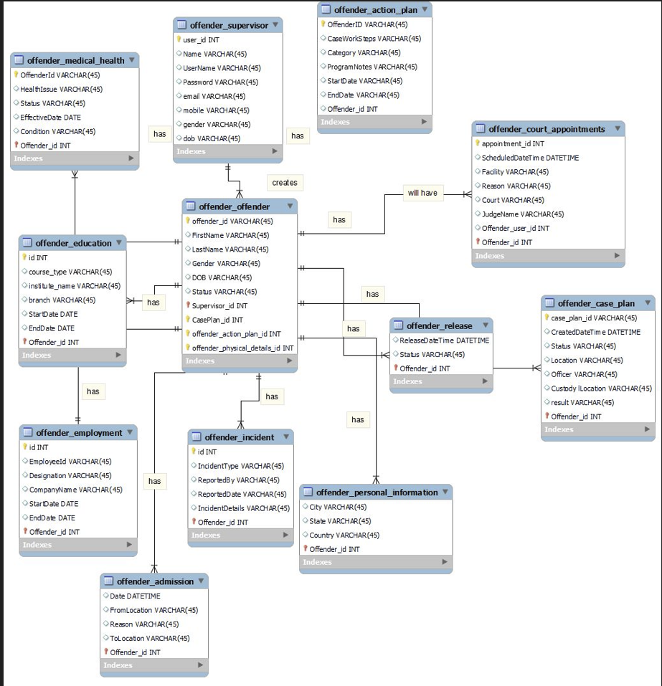
ER Diagram

Slide 29
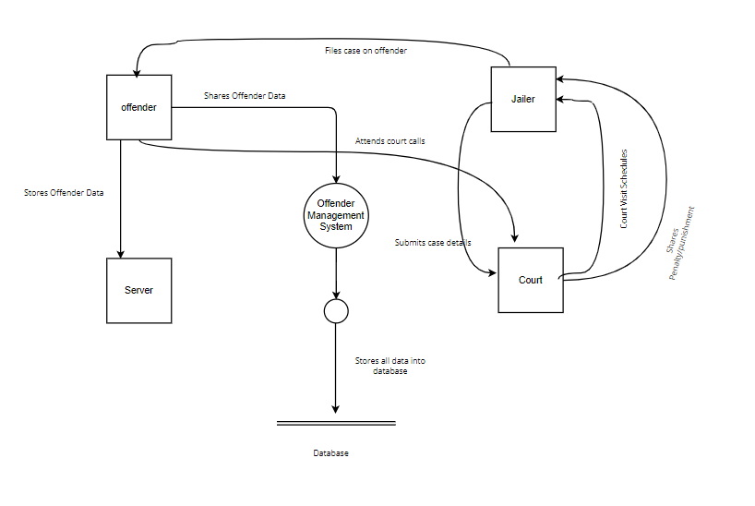
Preliminary Interface model - Context diagram

Slide 30
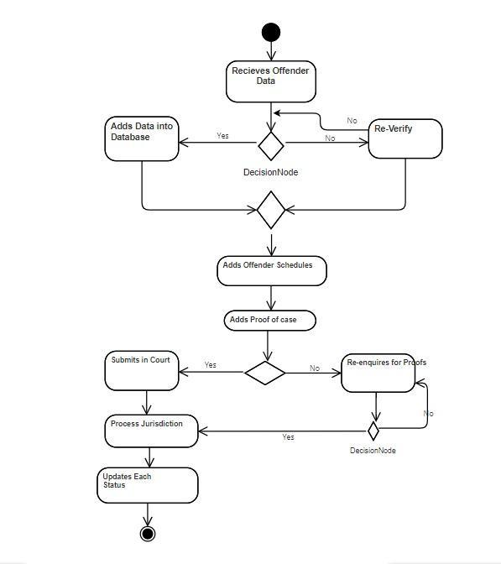
Activity Diagram

Slide 31
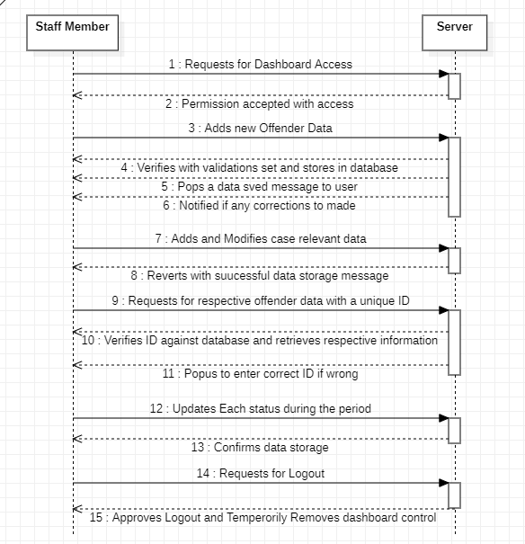
Sequence Diagram

Slide 32

Technologies Used
1. Software:
Python (free)
PostgreSQL Database (free)
2. Hardware:
Laptops
External Monitors
Any device with Browser Installed

Slide 33
THANK YOU

